Slide 1
Predicting the Presence of Heart Disease with Machine Learning
Brian Chen, Michelle Ikoma, Juan Shi, John Won

Slide 2
Background
Gradual disease onset with long asymptomatic phase
Lots of research on detecting heart disease in earlier stages
Heart disease is the leading cause of death in the U.S.
Catastrophic event (e.g. heart attacks) are often first sign of heart disease
Machine learning & data science have tremendous potential to advance care
Notes:
Michelle

Slide 3
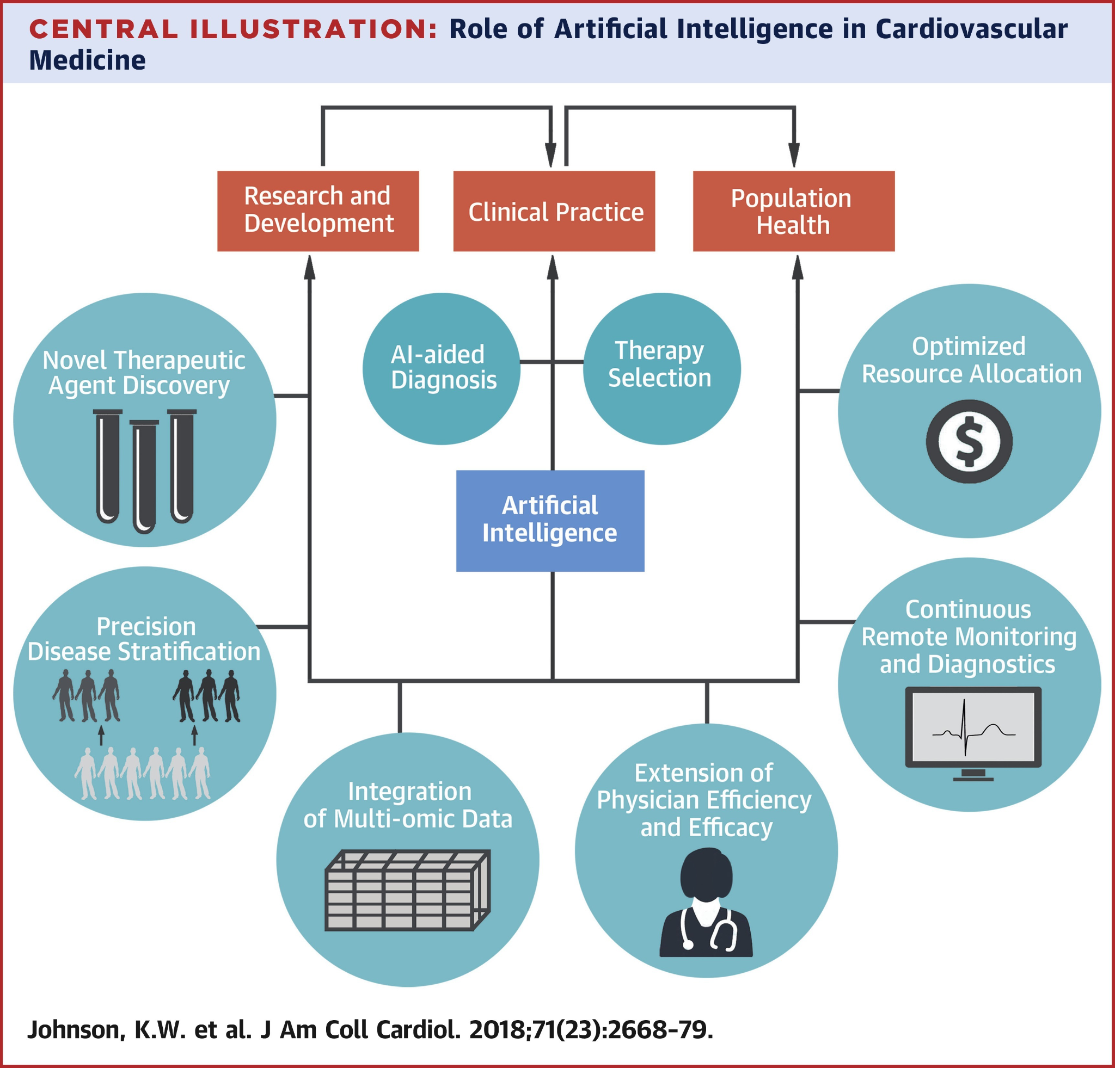
Machine Learning in Cardiovascular Disease

Slide 4
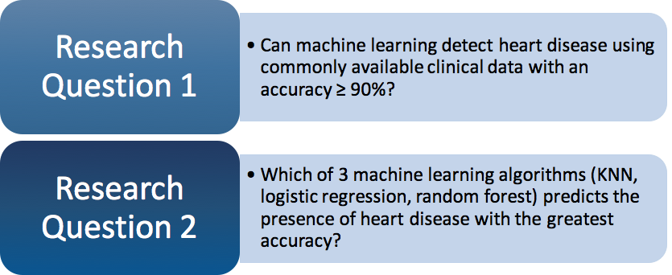
Research Questions

Slide 5
Methods
Data Source: Kaggle.com “Heart Disease UCI””
Overall: 5 Cross-Validation
Logistic Regression
K-nearest neighbor (KNN)
Random Forest
Notes:
Juan

Slide 6
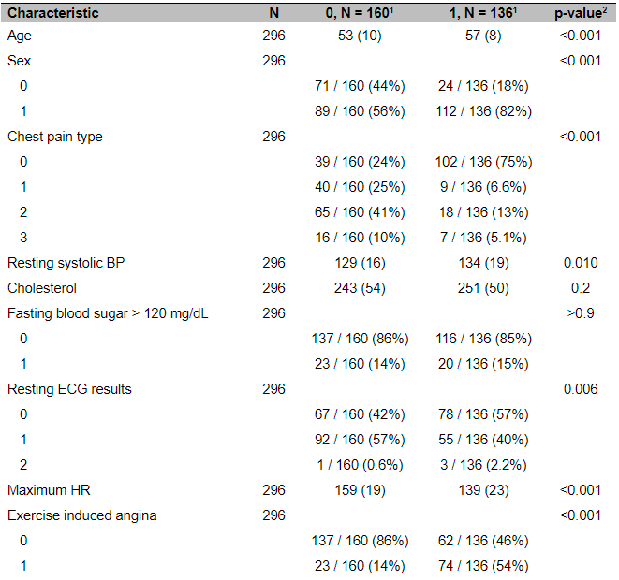
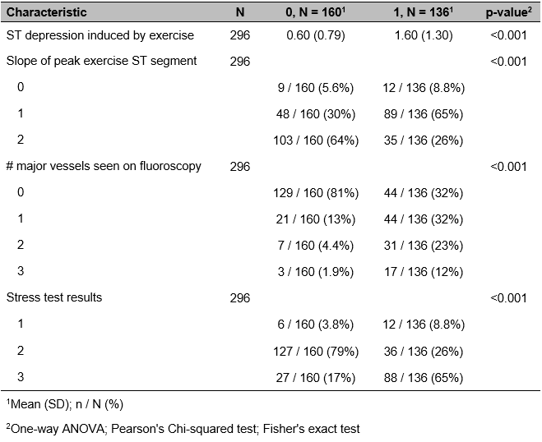
Results
Notes:
Brian

Slide 7
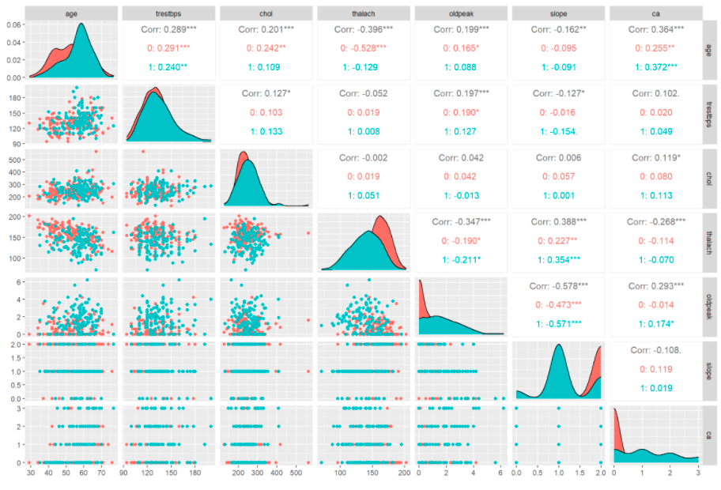
Results

Slide 8
Results
Tuning for Random Forest
Average Youden’s Index
# of Trees | # of Features | OOB Error
500 | 6.500 | 0.156
500 | 3.606 | 0.152
250 | 6.500 | 0.194
250 | 6.500 | 0.169
250 | 13.000 | 0.190
Mean | Standard Deviation
0.475 | 0.207
Average Number of Neighbors
Mean | Standard Deviation
21.4 | 1.673

Slide 9
Results
Method | CV Error Mean | CV Standard Error
Logistic: 0.5 Threshold | 0.165 | 0.032
Logistic: Youden's Index | 0.132 | 0.039
KNN | 0.162 | 0.033
Random Forest | 0.199 | 0.047

Slide 10
Results
Method | CV Sensitivity | CV Sensitivity SE | CV Specificity | CV Specificity SE
Logistic: 0.5 Threshold | 0.779 | 0.069 | 0.881 | 0.056
Logistic: Youden's Index | 0.861 | 0.111 | 0.875 | 0.062
KNN | 0.809 | 0.096 | 0.863 | 0.052
Random Forest | 0.757 | 0.094 | 0.838 | 0.068

Slide 11
Discussion
Relevance:
1 in 4 deaths in U.S. due to heart disease
22.9% of American adults get recommended exercise
14.0% are cigarette smokers
Our Approach:
Take advantage of an abundance of medical data
Machine learning as a tool for more efficient, convenient, and personalized clinical practice
Notes:
John

Slide 12
Discussion
Best model: Logistic Regression w/ Youden’s Index
Highest true positive rate
Lowest CV error
Accuracy greater than 90% was not achieved with any of our models
Disadvantages of certain models
Notes:
John

Slide 13
Future Direction
Improving the Accuracy
Test more algorithms
Add more variables
Apply to the real life
Combine the model with wearable devices
Using as a reference during diagnosis
Notes:
Juan

Slide 14
Works Cited
Al’Aref, S. J., Anchouche, K., Singh, G., Slomka, P. J., Kolli, K. K., Kumar, A., Pandey, M., & Maliakal, G. (2019). Clinical applications of machine learning in cardiovascular disease and its relevance to cardiac imaging. 40(24), 1975–1986.
Ambale-Venkatesh, B., Yang, X., Wu, C. O., Liu, K., Hundley, W. G., McClelland, R., Gomes, A. S., Folsom, A. R., Shea, S., Guallar, E., Bluemke, D. A., & Lima, J. A. C. (2017). Cardiovascular Event Prediction by Machine Learning: The Multi-Ethnic Study of Atherosclerosis. Circulation Research, 121(9), 1092–1101. https://doi.org/10.1161/CIRCRESAHA.117.311312
Blackwell, D. L., & Clarke, T. C. (2018). State Variation in Meeting the 2008 Federal Guidelines for Both Aerobic and Muscle-strengthening Activities Through Leisure-time Physical Activity Among Adults Aged 18–64: United States, 2010–2015. National Health Statistics Reports. No. 112. https://www.cdc.gov/nchs/data/nhsr/nhsr112.pdf
CDC. (2021). Burden of Cigarette Use in the U.S. Centers for Disease Control and Prevention. https://www.cdc.gov/tobacco/campaign/tips/resources/data/cigarette-smoking-in-united-states.html.
CDC. (2021). Heart Disease. Centers for Disease Control and Prevention. https://www.cdc.gov/heartdisease/.
Johnson, K. W., Torres Soto, J., Glicksberg, B. S., Shameer, K., Miotto, R., Ali, M., Ashley, E., & Dudley, J. T. (2018). Artificial Intelligence in Cardiology. Journal of the American College of Cardiology, 71(23), 2668–2679. https://doi.org/10.1016/j.jacc.2018.03.521
Kochanek, K. D., Xu, J., & Arias, E. (2020). Mortality in the United States, 2019 (NCHS Data Brief No. 395). National Center for Health Statistics (NCHS). https://www.cdc.gov/nchs/products/databriefs/db395.htm
R Core Team (2020). R: A language and environment for statistical computing. R Foundation for Statistical Computing, Vienna, Austria. https://www.R-project.org/.

Slide 15
Thank you! Any questions?

